Slide 1
Distributed Computer Systems
CT024-3-3-DCOMS and VE
Transaction Management

Slide 2
TOPIC LEARNING OUTCOMES
At the end of this topic, you should be able to:
Understand Transaction Management

Slide 3
Teaching Contents
Understand the concept of Transaction Management
Transaction Management – ACID Properties
Examples

Slide 4
Transaction
What is Transaction?
A transaction is a single logical unit of work which accesses and possibly modifies the contents of a database.
In order to maintain consistency in a database, before and after the transaction, certain properties are followed. These are called ACID properties.

Slide 5
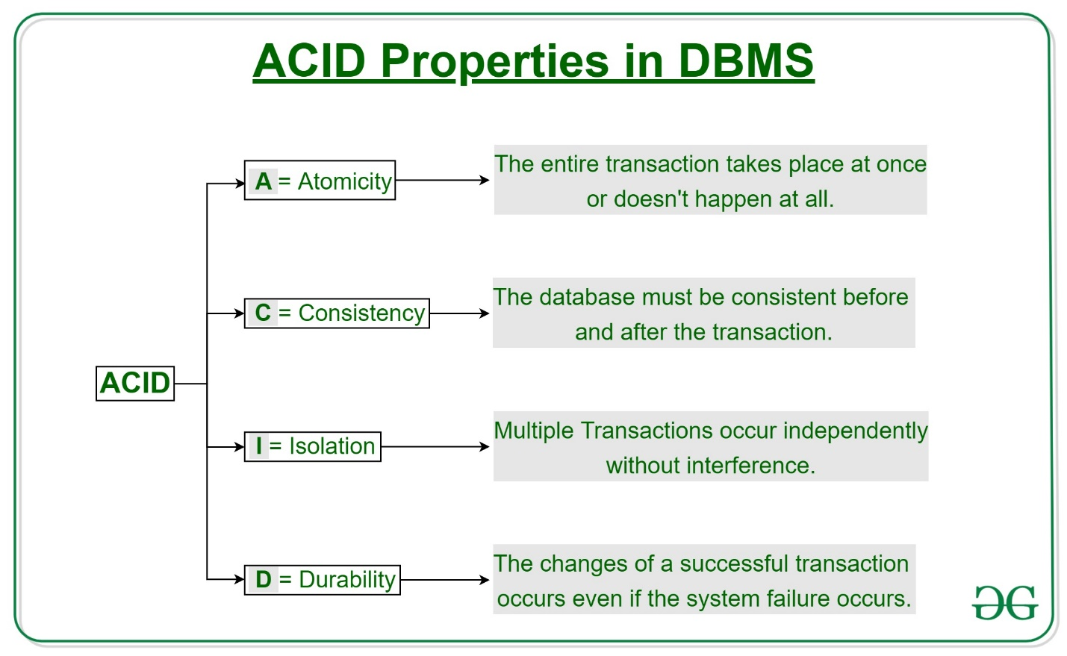

Slide 6
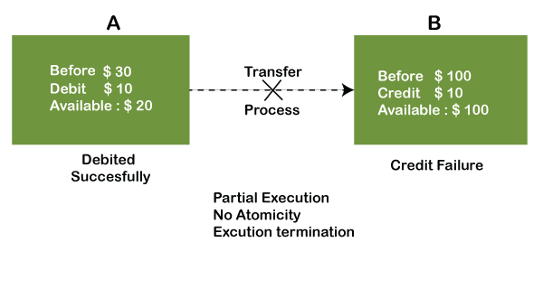
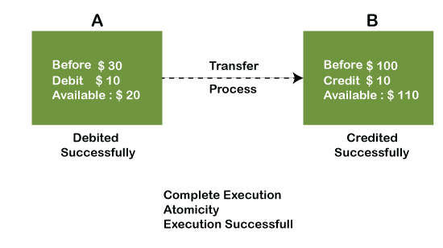
1) Atomicity
The term atomicity defines that the data remains atomic. It means if any operation is performed on the data, either it should be performed or executed completely or should not be executed at all. It further means that the operation should not break in between or execute partially.

Slide 7
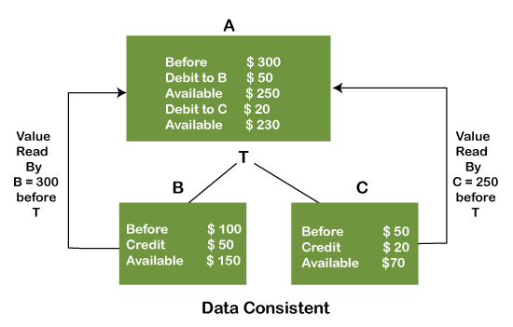
2) Consistency
The word consistency means that the value should remain preserved always. In DBMS, the integrity of the data should be maintained, which means if a change in the database is made, it should remain preserved always.

Slide 8
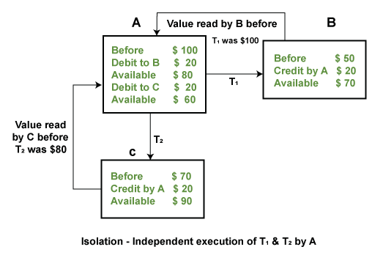
3) Isolation
The term 'isolation' means separation. In DBMS, Isolation is the property of a database where no data should affect the other one and may occur concurrently. In short, the operation on one database should begin when the operation on the first database gets complete. It means if two operations are being performed on two different databases, they may not affect the value of one another. In the case of transactions, when two or more transactions occur simultaneously, the consistency should remain maintained.
Example: If two operations are concurrently running on two different accounts, then the value of both accounts should not get affected. The value should remain persistent. As you can see in the below diagram, account A is making T1 and T2 transactions to account B and C, but both are executing independently without affecting each other. It is known as Isolation.

Slide 9
4) Durability
Durability ensures the permanency of something. In DBMS, the term durability ensures that the data after the successful execution of the operation becomes permanent in the database. The durability of the data should be so perfect that even if the system fails or leads to a crash, the database still survives. However, if gets lost, it becomes the responsibility of the recovery manager for ensuring the durability of the database. For committing the values, the COMMIT command must be used every time we make changes.
Therefore, the ACID property of DBMS plays a vital role in maintaining the consistency and availability of data in the database.

Slide 10
Exercise

Slide 11
Review Questions
What is Transaction?
Explain the transaction management properties ACID.

Slide 12
Summary / Recap of Main Points
Transaction Management

Slide 13
What To Expect Next Week
In Class
Virtualization

